Slide 1


MINI PROJECT (2021-22)
Sidekick of Semester (SOS)

Slide 2
PRESENTATION ON
PREPARED BY: ABHISHEK SINGHAL THIRD SEMESTER
DEPARTMENT OF :
COMPUTER SCIENCE AND ENGINEERING (CS&IT)
SIDEKICK ON SEMISTER (SOS)

Slide 3
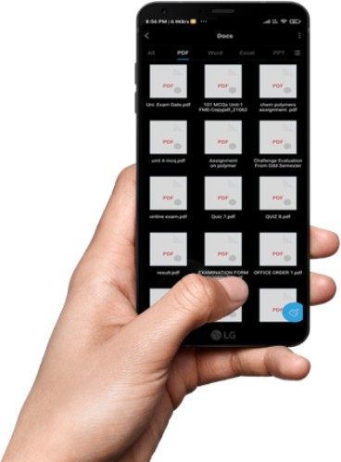
Problem Statement
B.Tech is of 4year having an 8-semester exam and most of our time is wasted in managing notes as well finding them from messy phone and laptop.
So, This SOS (Sidekick of the semester) saves you most of the time. As here you will get all of the notes for your subject.
Sidekick means helper,
And the whole Sidekick of Semester means helper of semester

Slide 4
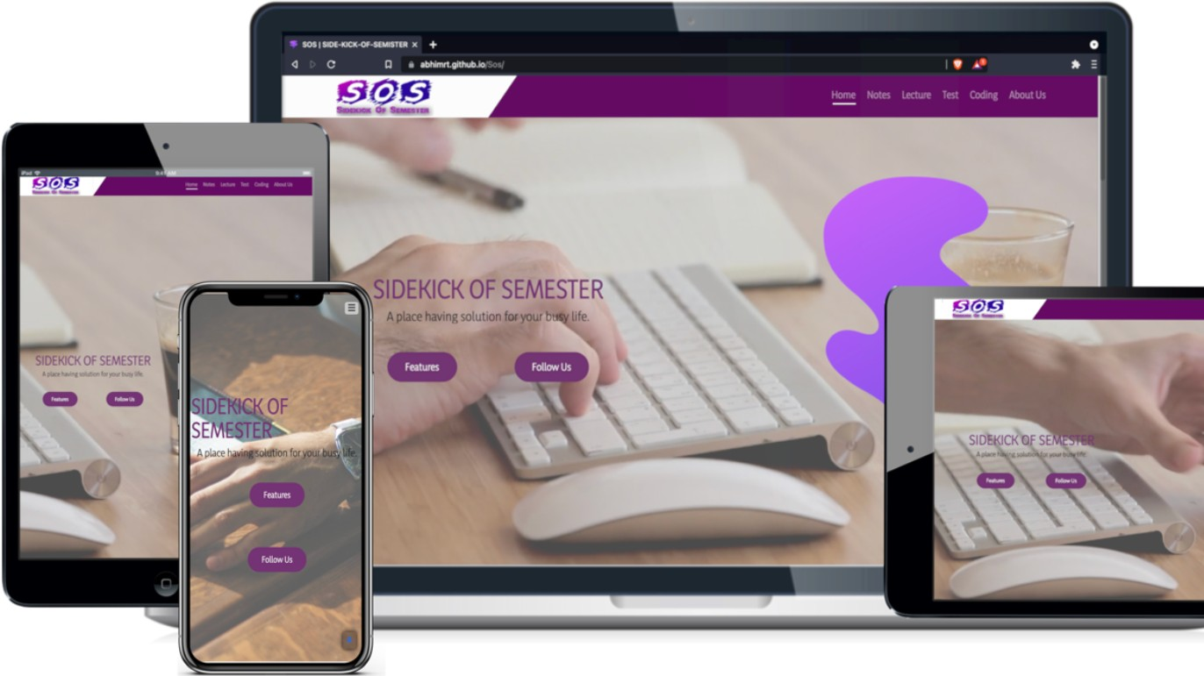
Speciality of Website
This website can run on any of the devices it doesn’t matter what is the size of
the device. This website is fully responsive.

Slide 5





HOME PAGE
It was the main page of my website.
From this page, you can navigate to another page of the website.
FEATURES OF WESITE
NOTES PROVIDER
MCQ QUESTIONS
QUESTION PAPER
CODING
VIDEO LECTURES

Slide 6
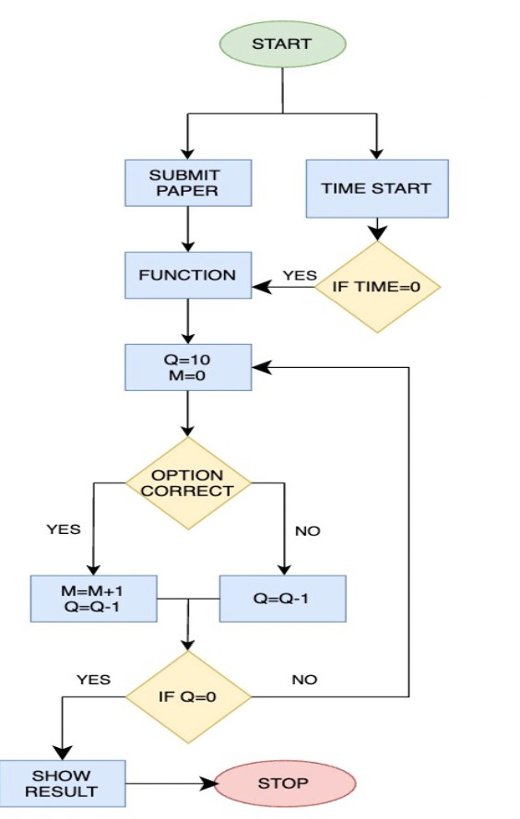
MCQ TEST SECTION
This page contain test which helps you in your training.
SPECIALITY OF TEST
As per security purposes, right-click on this website is off.
There was a time limit to make the test secure.
You have to choose all options before submitting.
It will show a pass if the candidate scores more than 5marks.

Slide 7

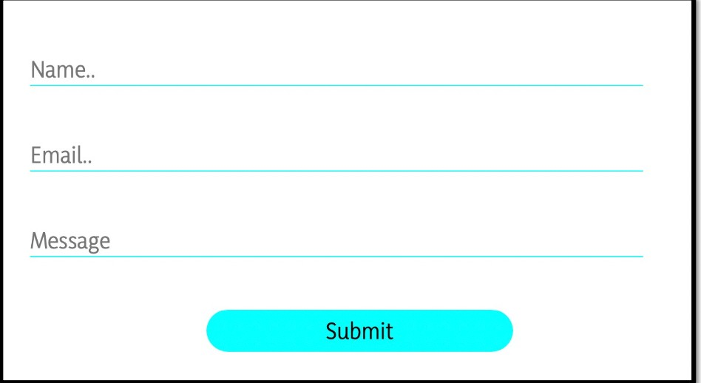
ABOUT US SECTION
SPECIALITY OF ABOUT US:
Here you will get a small form containing 3 text areas in the first one you have
to enter your name, in the second one you have to enter your email address, and in the last one, you have to write a message.
After clicking on submit button the response will submit to an excel file that already exists on the drive.

Slide 8
Resource Page
UNSPLASH
FOR IMAGES
FONT AWESOME
FOR ICONS
GOOGLE FONTS
FOR FONTS
BOOTSTRAP
FOR FRAMEWORK OF CSS
MAKE MY WORK EASY

Slide 9


WEBSITE LINKS
WEBSITE LINK
CODE LINK
GITHUB LINK

Slide 10

Thank you!
Feel free to approach me if you have any questions.

